Slide 1
THESIS PROPOSAL
Satellite Ground Station
for
CubeSats and LEO satellites

Slide 2
CONTENTS
Introduction
Literature review
Method and expected outcomes
Timeline
Budget plan

Slide 3
Introduction
A kick-start in space engineering
There are considerable “herd” of satellites up there!
Notes:
Khoa học vũ trụ và kỹ thuật hàng không hiện đại đang gặt hái rất nhiều thành công. Trong quá trình thương mại hóa không gian, sự tham gia của các công ty tư nhân vào lĩnh vực này khiến cho công nghệ chế tạo phát triển vượt bậc kéo theo rất nhiều chi phí giảm đi đáng kể so với nhiều thập kỷ trước, đặc biệt là về kỹ thuật chế tạo vệ tinh. Số lượng các vệ tinh này đang gia tăng rất nhanh, nhất là Cubesat – một loại vệ tinh nhỏ có kích thước đơn vị 10cmx10cmx10cm thực hiện được nhiều nhiệm vụ quan trọng

Slide 4
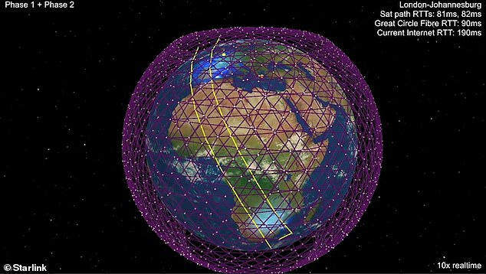
“SpaceX successfully launches first 60 satellites in massive Starlink internet constellation“ – The Verge
NextBigFuture.com

Slide 5
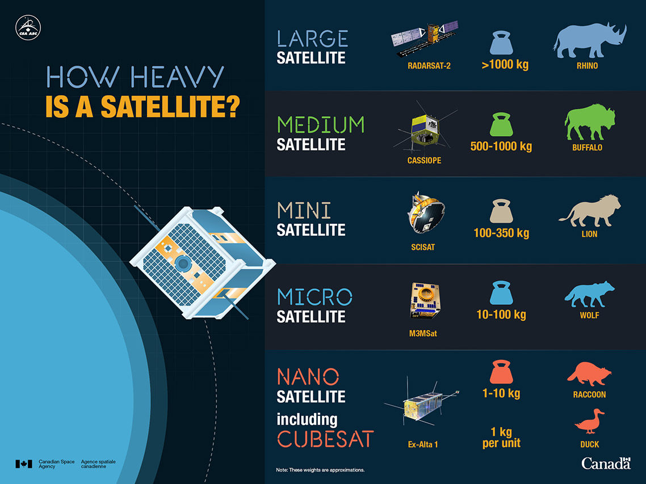

Slide 6
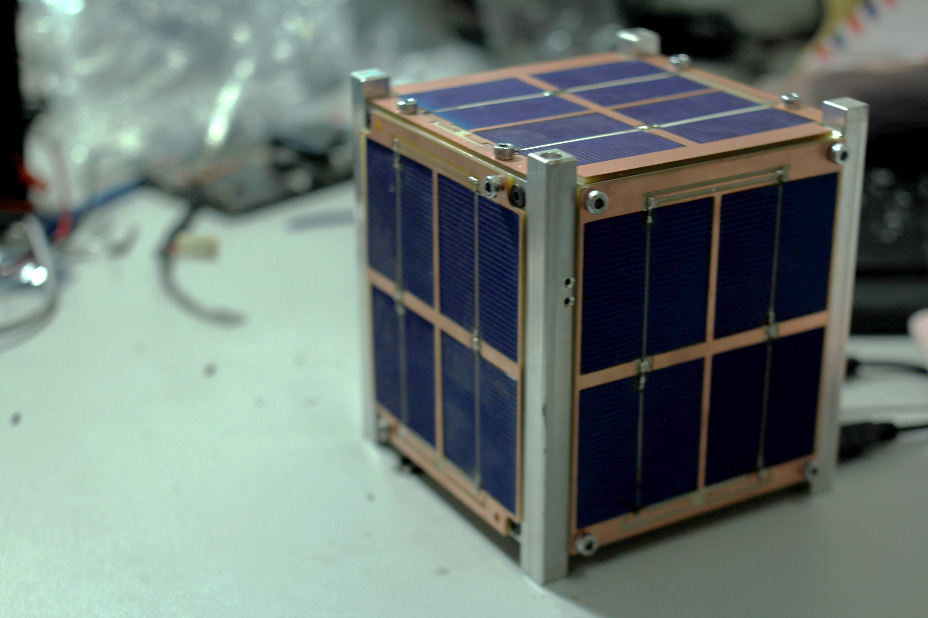

Slide 7
Introduction
A kick-start in space engineering
There are considerable “herd” of satellites up there!
Links must be established -> How?
Notes:
Trạm mặt đất là hệ thống dùng để giao tiếp với các vệ tinh hoặc thiết bị bay [2]. Việc thiết kế các trạm này sao cho phù hợp với số lượng đông đúc các vệ tinh mà vẫn đảm bảo tính ổn đinh, độ linh hoạt với nhiều vệ tinh và chi phí thấp là vô cùng cần thiết. Từ các lợi thế này, có thể nhân rộng để khai thác cho mục đích thương mại.

Slide 8
SATELLITE GROUND STATION
Notes:
Trạm mặt đất là hệ thống dùng để giao tiếp với các vệ tinh hoặc thiết bị bay [2]. Việc thiết kế các trạm này sao cho phù hợp với số lượng đông đúc các vệ tinh mà vẫn đảm bảo tính ổn đinh, độ linh hoạt với nhiều vệ tinh và chi phí thấp là vô cùng cần thiết. Từ các lợi thế này, có thể nhân rộng để khai thác cho mục đích thương mại.

Slide 9
Literature review
Ground station functionality
------------------------------------- Tracking mechanism

Slide 10
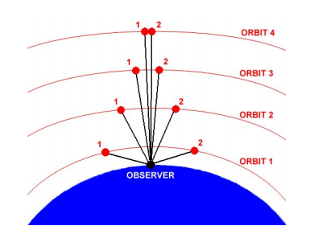
S. P. A. N. Erika Pittella, "Design of an Antenna System for CubeSat Satellites," in 2nd IAA Conference on University Satellites Missions and CubeSat Winter Workshop, 2013.

Slide 11
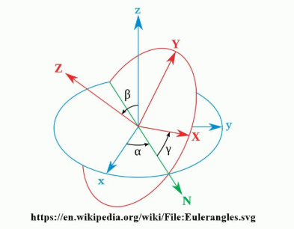
Notes:
You may be familiar with this guy

Slide 12
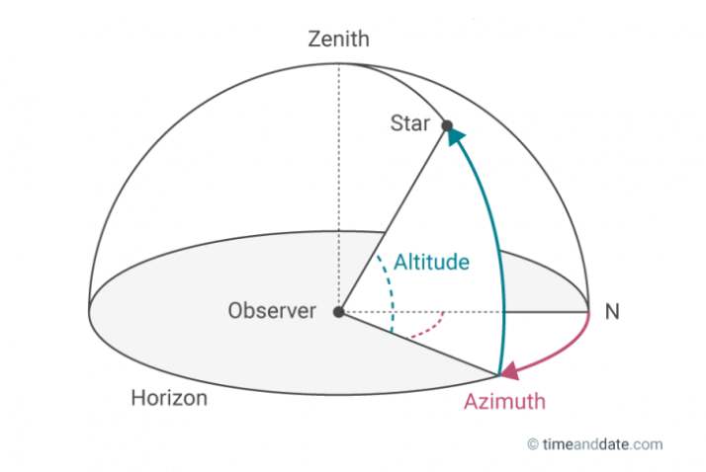
Notes:
Now, there is another reference frame: of Azimuth and Elevation

Slide 13
Literature review
Ground station functionality
------------------------------- Tracking mechanism
------------------------------- Radio frequency transceiver

Slide 14

Literature review
Ground station functionality
------------------------------- Tracking mechanism
------------------------------- Radio frequency transceiver

Slide 15


Slide 16
Literature review
Ground station functionality
------------------------------- Tracking mechanism
------------------------------- Radio frequency transceiver
------------------------------- Signal processing

Slide 17
Literature review
Ground station functionality
Vinasat 1,2
--------------------------- They are geostationary satellites
--------------------------- They do have ground station

Slide 18
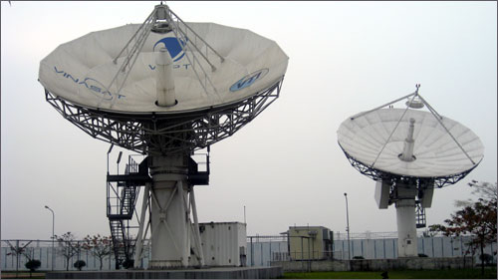
Ground station at Cát Quế, Hoài Đức – Hà Nội
vov.vn

Slide 19
Literature review
Ground station functionality
Vinasat 1,2
Micro Dragon

Slide 20
Literature review
Ground station functionality
Vinasat 1,2
Micro Dragon
------------------------ Built by VNSC, in the help of Japan

Slide 21
Literature review
Ground station functionality
Vinasat 1,2
Micro Dragon
------------------------ Built by VNSC, in the help of Japan
------------------------ Manufactured in Japan

Slide 22
Literature review
Ground station functionality
Vinasat 1,2
Micro Dragon
------------------------ Built by VNSC, in the help of Japan
------------------------ Manufactured in Japan
------------------------ Launched by Japan

Slide 23
Literature review
Ground station functionality
Vinasat 1,2
Micro Dragon
------------------------ Built by VNSC, in the help of Japan
------------------------ Manufactured in Japan
------------------------ Launched by Japan
------------------------ Observed by JAXA - Japan

Slide 24
Literature review
Ground station functionality
Vinasat 1,2
Micro Dragon
------------------------ Built by VNSC, in the help of Japan
------------------------ Manufactured in Japan
------------------------ Launched by Japan
------------------------ Observed by JAXA - Japan
------------------------ Vietnamese proudness !??
Notes:
JAXA | Japan Aerospace Exploration Agency

Slide 25
Literature review
Ground station functionality
Vinasat 1,2
Micro Dragon
Pico Dragon and Nano Dragon

Slide 26
Literature review
Ground station functionality
Vinasat 1,2
Micro Dragon
Pico Dragon and Nano Dragon
Commercial solutions

Slide 27
Literature review
Ground station functionality
Vinasat 1,2
Micro Dragon
Pico Dragon and Nano Dragon
Commercial solutions
------------------------ CubeSatsShop, ISIS Space…

Slide 28
Literature review
Ground station functionality
Vinasat 1,2
Micro Dragon
Pico Dragon and Nano Dragon
Commercial solutions
------------------------ CubeSatsShop, ISIS …
------------------------ Full options: 86.500 EURO

Slide 29
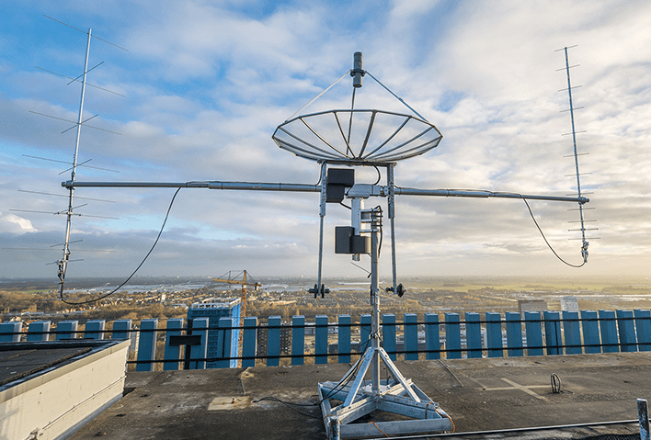
Full options kit of ISIS
www.isisspace.nl
Notes:
ISIS - Innovative Solutions In Space, - Netherland
Motorenweg 23, 2623 CR Delft

Slide 30
Literature review
Ground station functionality
Vinasat 1,2
Micro Dragon
Pico Dragon and Nano Dragon
Commercial solutions
Limited payload

Slide 31
Literature review
Ground station functionality
Vinasat 1,2
Micro Dragon
Pico Dragon and Nano Dragon
Commercial solutions
Limited payload
------------------------ 2 yagis and 1 parabolic antenna
------------------------ Investigation for RF is significant

Slide 32
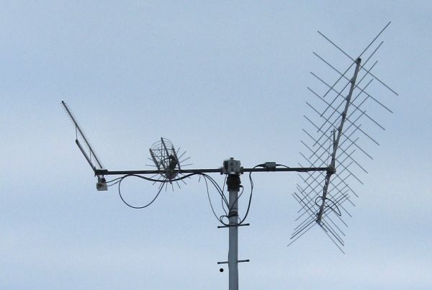
blogs.aalto.fi

Slide 33
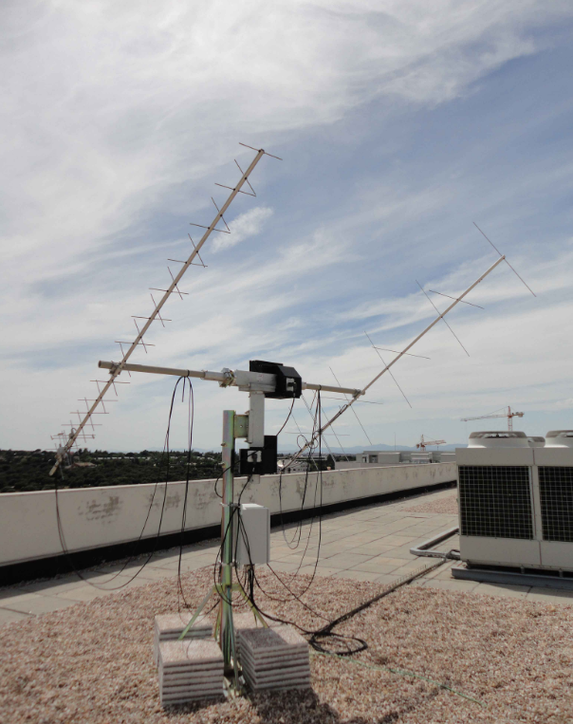
eusoc.upm.es

Slide 34
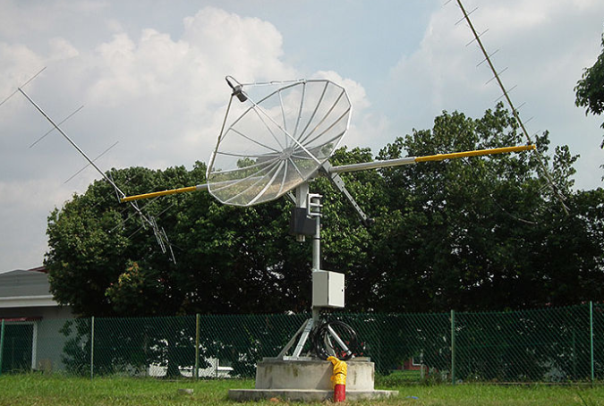
CubeSatShop.com

Slide 35
Literature review
Ground station functionality
Vinasat 1,2
Micro Dragon
Pico Dragon and Nano Dragon
Commercial solutions
Limited payload

Slide 36
Literature review
Ground Station
Ground station functionality
Vinasat 1,2
Micro Dragon
Pico Dragon and Nano Dragon
Commercial solutions
Limited payload
For CubeSat
Low cost
Universal
antennas
mounting

Slide 37
Ground Station
For CubeSat
Low cost
Universal
antennas
mounting

Slide 38
Novelties
Functionality for CubeSats/Nanosats
Universal antennas mounting and multiple frequencies hopping
Low cost, estimated by budget plan

Slide 39
Methods
Literature research on space engineering, spacecraft dynamic and satellite communicating

Slide 40
Methods
Literature research on space engineering, spacecraft dynamic and satellite communicating
------------------------ Keplerian elements
------------------------ Satellites ADCS
------------------------ Radio link and communication

Slide 41
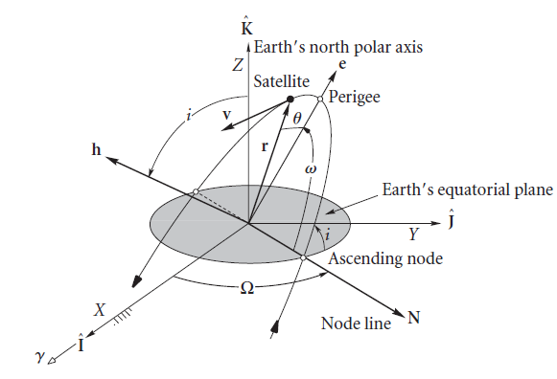
Keplerian elements
adcsforbeginners.wordpress.com

Slide 42
Method
Literature research on space engineering, spacecraft dynamic and satellite communicating
Designing and building rotary system with computer interfaces software

Slide 43
Method
Literature research on space engineering, spacecraft dynamic and satellite communicating
Designing and building rotary system with computer interfaces software
------------------------ Hardware design and construct
------------------------ Host computer controlled
------------------------ Software calculating position
------------------------ Firmware in sub-system

Slide 44
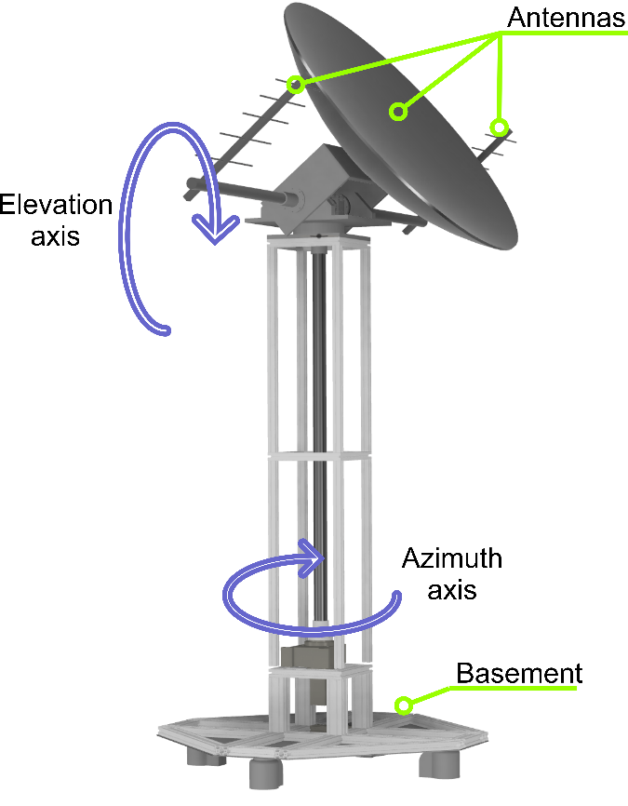
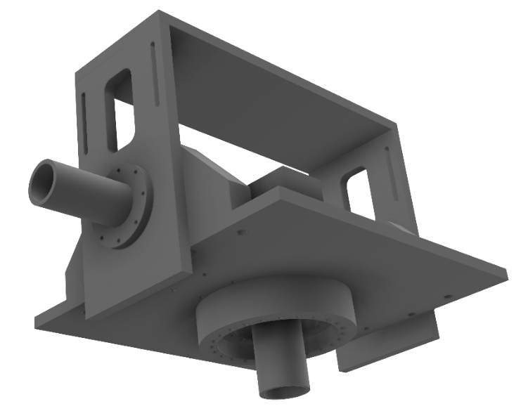
Rotary system

Slide 45
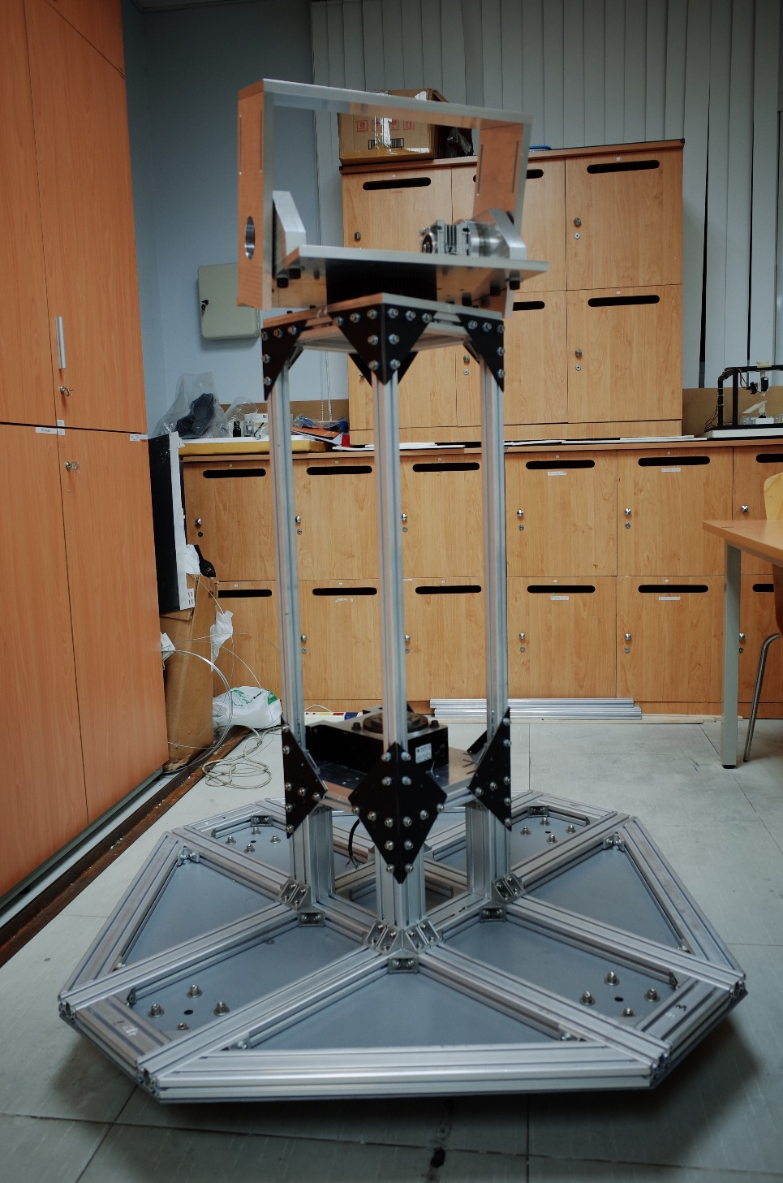
In construction

Slide 46

In construction and me!

Slide 47
Method
Literature research on space engineering, spacecraft dynamic and satellite communicating
Designing and building rotary system with computer interfaces software
RF design

Slide 48
Method
Literature research on space engineering, spacecraft dynamic and satellite communicating
Designing and building rotary system with computer interfaces software
RF design
------------------------ Antennas design and constructing
------------------------ Filters, amplifier
------------------------ Signal processing software

Slide 49
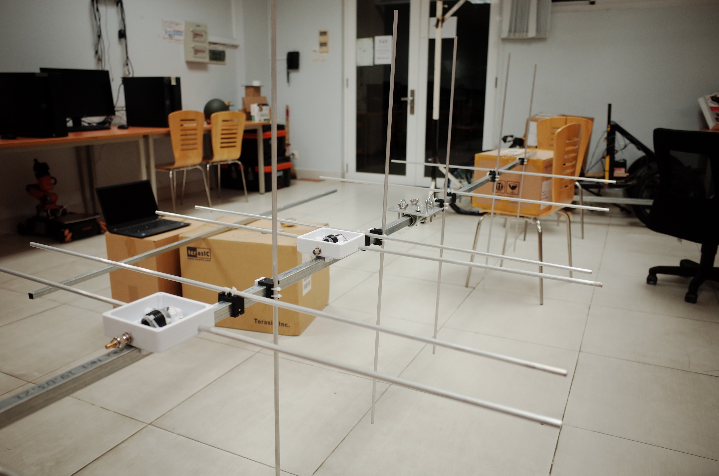

Slide 50
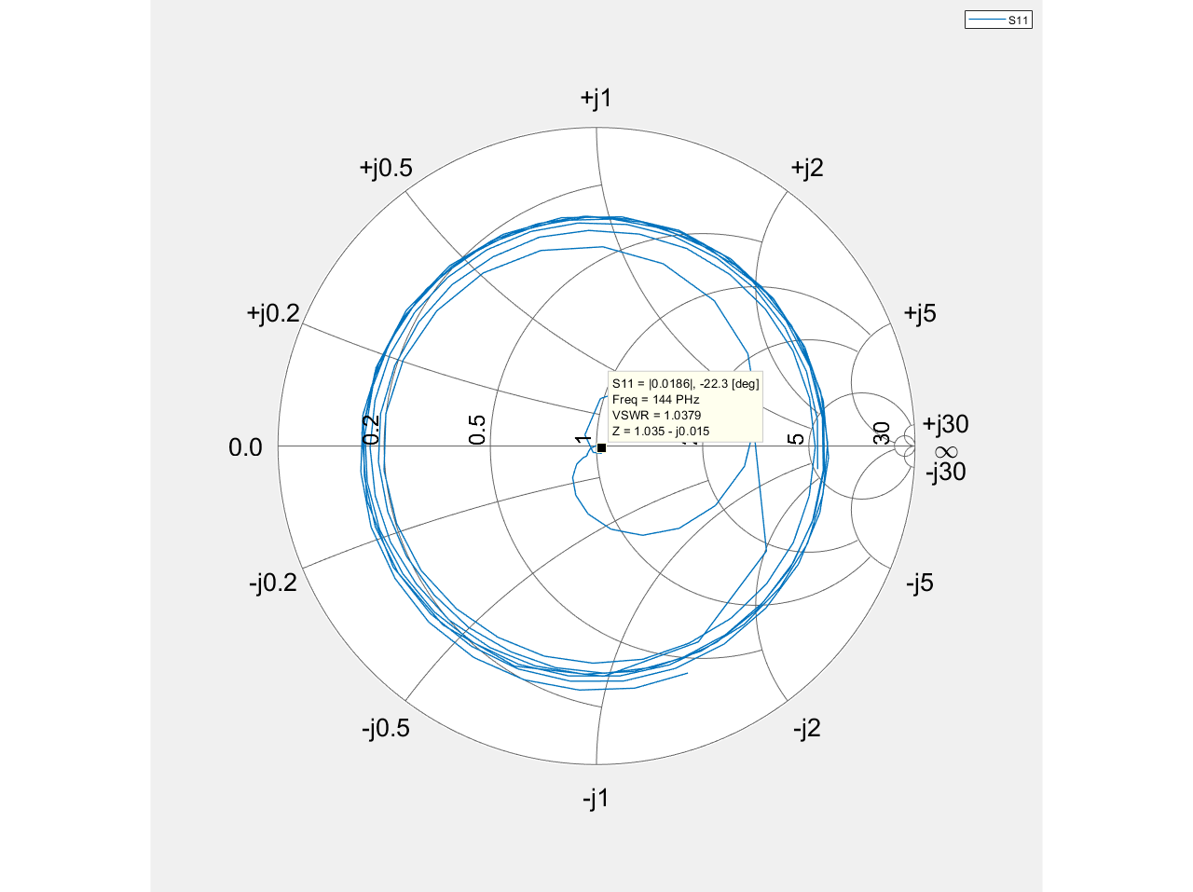
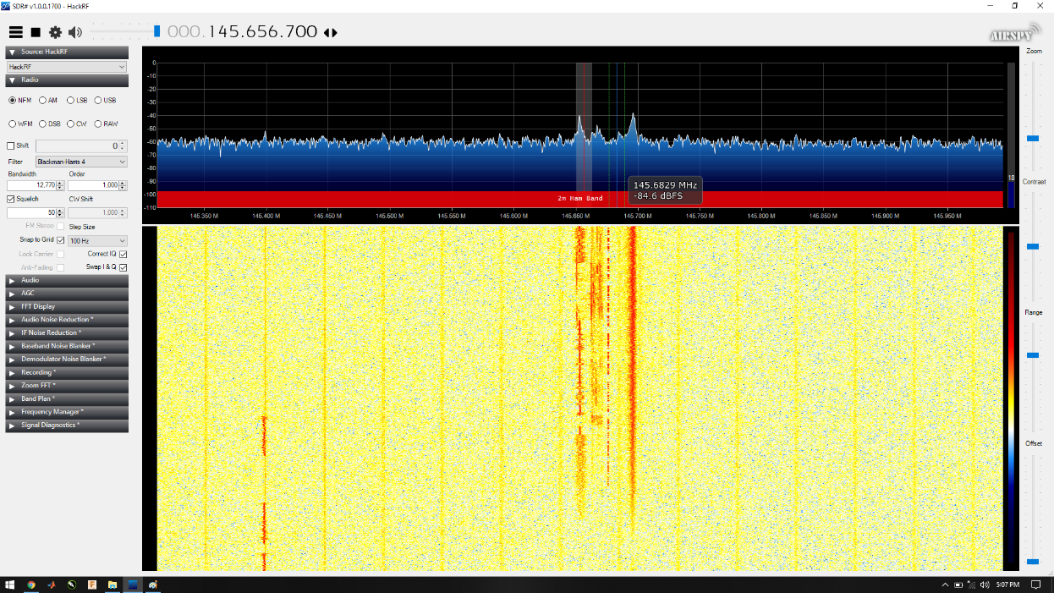
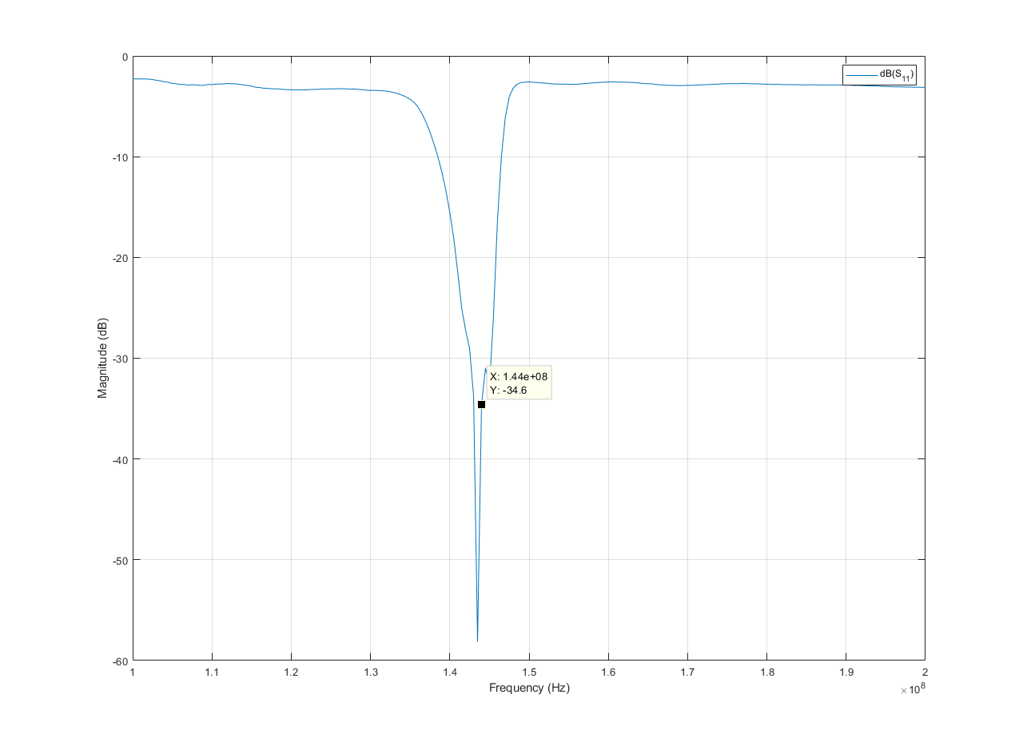
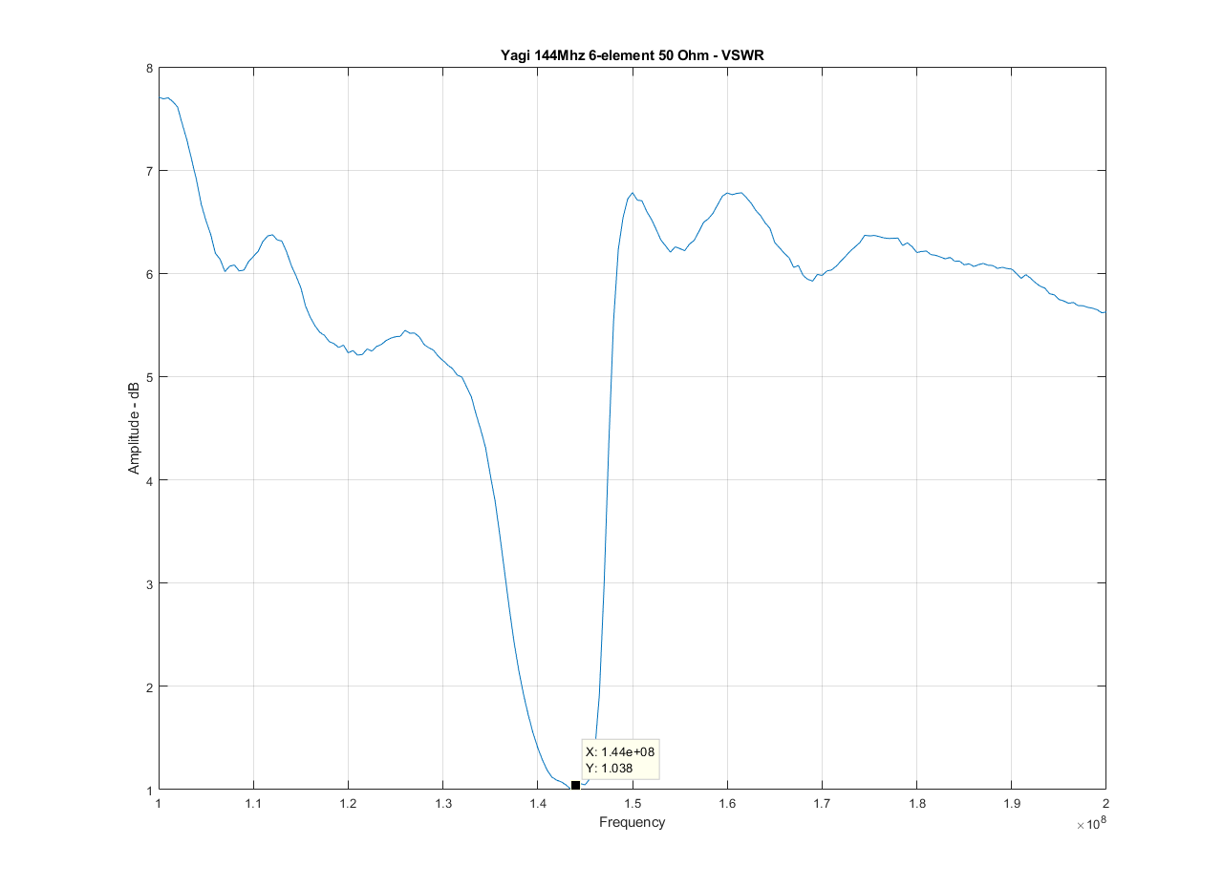

Slide 51
Method
Literature research on space engineering, spacecraft dynamic and satellite communicating
Designing and building rotary system with computer interfaces software
RF design
Evaluate the accuracy

Slide 52
Method
Literature research on space engineering, spacecraft dynamic and satellite communicating
Designing and building rotary system with computer interfaces software
RF design
Evaluate the accuracy
------------------------ Evaluate the rotary tolerance
------------------------ Evaluate the RF system

Slide 53
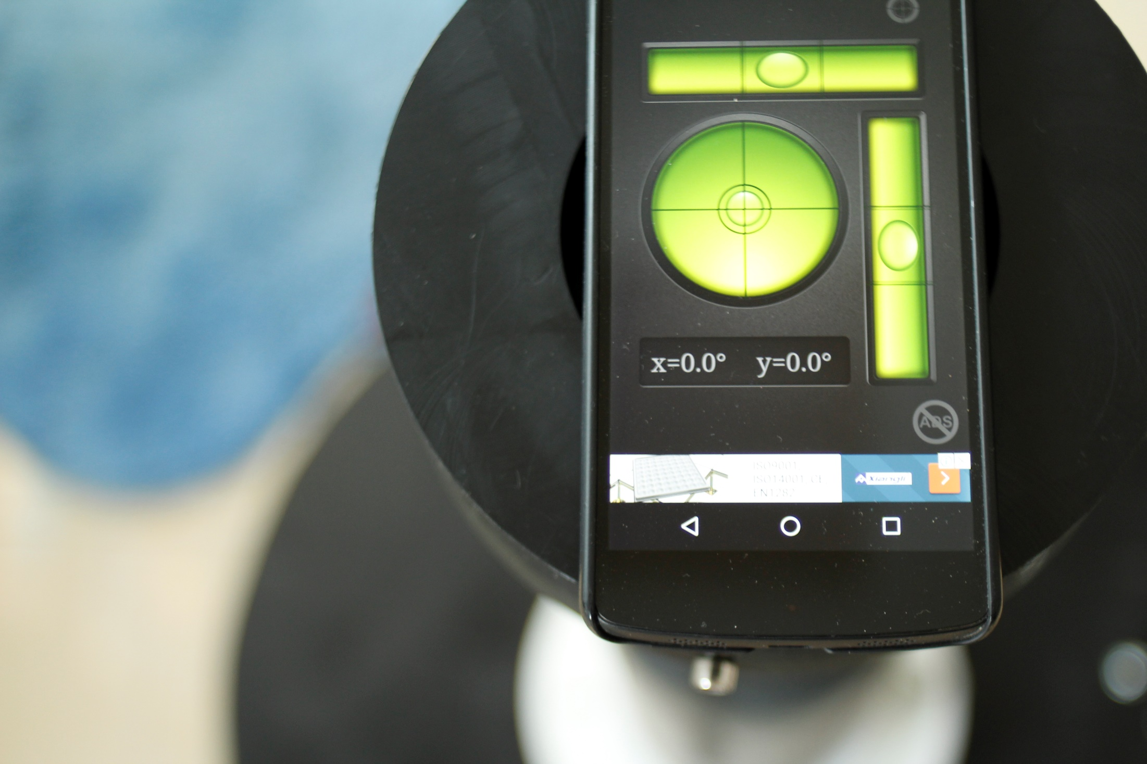

Slide 54
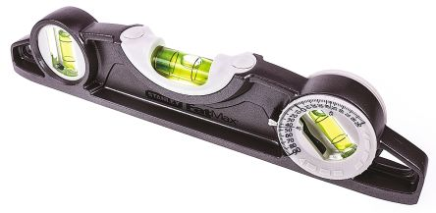
Bubble meter
uk.rs-online.com

Slide 55
Method
Literature research on space engineering, spacecraft dynamic and satellite communicating
Designing and building rotary system with computer interfaces software
RF design
Evaluate the accuracy
Report and finalizing

Slide 56
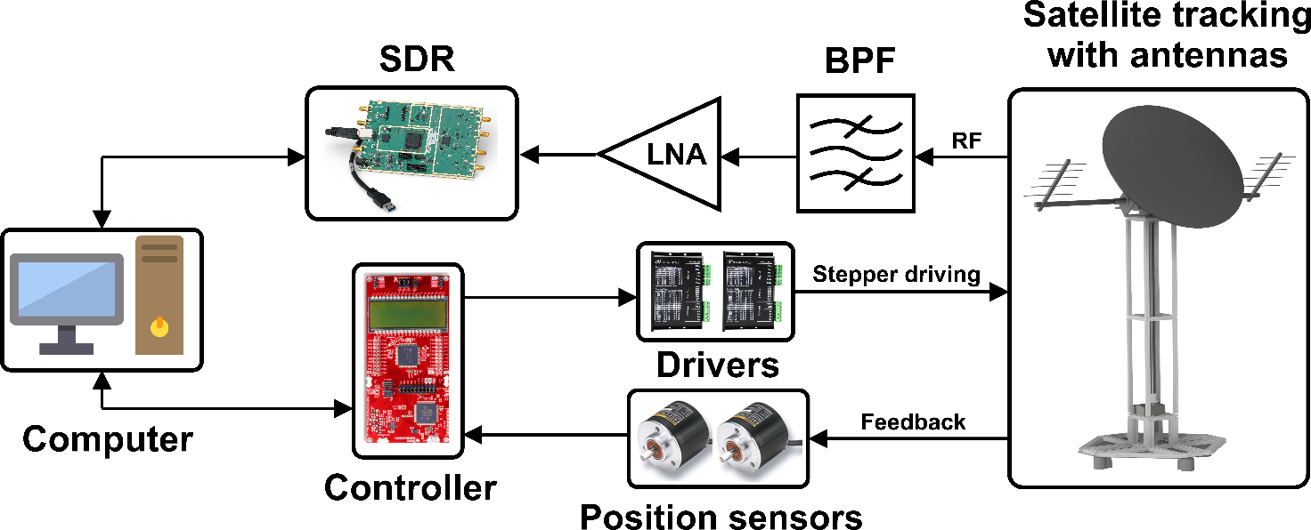
General system diagram

Slide 57
Expected outcomes
 | Description | Criteria/Deliverable
Hardware | Two axes rotational system with universal mount for satellite tracking purpose and its controller working in both manual and automatic mode | . Mechanical frame . Two axes with accuracy ±5 degrees and speed of 1 degree/second in minimum . Have ability to be mounted: + Parabolic antenna: 3m diameter, 20kg + Two Yagi antennas: 0.5m x 0.5m x 2m, 5kg . Wide range working frequency based on capacity of the used SDR (USRP B210: 70Mhz to 6Ghz)
Software | A program interfacing with SDR for frequency switching and signal processing | . Software to control the azimuth and elevation axis manually by tuning gauge in user interface. . Software has availability to track the LEO satellite automatically. . Software can interface with SDR, tuning frequencies. . Software can receive the beacon signal and un-decoded downlink data.
Paper |  | Paper about Satellite ground station using SDR.

Slide 58
Timeline
1-year project
Tasks will be assigned to team members in detail

Slide 59
Timeline
Step | From | To | Duration | Jobs | Detail
1 | October 21st , 2018 | December 1st , 2018 | 1.5 months | Literature review and planning for the structure | Statistic the need of SGS
 |  |  |  |  | Satellite communicating
 |  |  |  |  | Dynamic of spacecraft
 |  |  |  |  | Mechanism of structure
2 | December 6th, 2018 | April 29th, 2019 | 5 months | Building rotary system | Detail design of mechanical structure
 |  |  |  |  | Construct the structure
 |  |  |  |  | Design electrical system
 |  |  |  |  | Software programing and graphic user interface

Slide 60
Timeline
Step | From | To | Duration | Jobs | Detail
3 | February 1st, 2019 | May 29th, 2019 | 4 months | SDR research | Interfacing with SDR to turning frequency and signal processing
 |  |  |  |  | Construct antenna feed line and switching
 |  |  |  |  | Combine the SDR part to software at step 2
4 | June 1st , 2019 | August 15th, 2019 | 2.5 months | Evaluate the model | Evaluate the accuracy of orienting
 |  |  |  |  | Perform the tracking ability on broadcast signal of satellite
5 | August 20th, 2019 | October 1st, 2019 | 1.5 months | Complete the report and papers | Writing report
 |  |  |  |  | Paper for rotary part
 |  |  |  |  | Paper for SDR part

Slide 61
Budget plan
107.000.000 VND - labor cost included
21 times lower than typical commercial version

Slide 62
Budget plan
Item | Estimated cost | Request funding | Note
Aluminum frame and accessories | 6.000.000 VND | 6.000.000 VND | This is used for constructing the frame on ground station. Which is popular in industry because of its convenience in high load strength and assembling easily
Aluminum sheet and billet | 3.000.000 VND | 3.000.000 VND | Aluminum sheet (6061 type) is used to fabricating parts of rotating structure.
Motor drive system (with controllers) | 8.000.000 VND | 8.000.000 VND | Harmonic and worm gear drive are for capacity of high load and precision.
Main controller | 2.000.000 VND | 2.000.000 VND | Proposed to use the MSP432 launchpad or similar device which can provide real time calculation.

Slide 63
Budget plan
PCB manufacturing and circuit components (power ICs, transistor, resistor…) | 3.000.000 VND | 3.000.000 VND | Some PCB would be made for attaching the main controller to connecting many peripherals.
Wire and connector for cable management | 1.000.000 VND | 1.000.000 VND
Parabolic antenna and Yagi antenna | 10.000.000 VND | 10.000.000 VND | Based on market research, one 3m parabolic antenna (around 30dBi) has price of nearly $300 and one Yagi is about $50
LNA filter, SMA, RF accessories | 2.000.000 VND | 2.000.000 VND
Manufacturing | 10.000.000 VND |  | Will be proposed to use CNC machines in GPEM labs
Labor | 60.000.000 VND |  | Brief estimate based on general working hours of team members
Misc (screws, nuts, spray, pulley, bearing, wheels, drills…) | 2.000.000 VND | 2.000.000 VND | Already paid in advance
Total | 107.000.000 VND | 37.000.000 VND | We already paid 19.000.000 VND in advance to start working seriously on this project.

Slide 64
Budget plan
Manufacturing | 10.000.000 VND |  | Will be proposed to use CNC machines in GPEM labs
Labor | 60.000.000 VND |  | Brief estimate based on general working hours of team members
Misc (screws, nuts, spray, pulley, bearing, wheels, drills…) | 2.000.000 VND | 2.000.000 VND | Already paid in advance
Total | 107.000.000 VND | 37.000.000 VND | We already paid 19.000.000 VND in advance to start working seriously on this project.
Manufacturing | 10.000.000 VND |  | Will be proposed to use CNC machines in GPEM labs
Labor | 60.000.000 VND |  | Brief estimate based on general working hours of team members
Misc (screws, nuts, spray, pulley, bearing, wheels, drills…) | 2.000.000 VND | 2.000.000 VND | Already paid in advance
Total | 107.000.000 VND | 37.000.000 VND

Slide 65
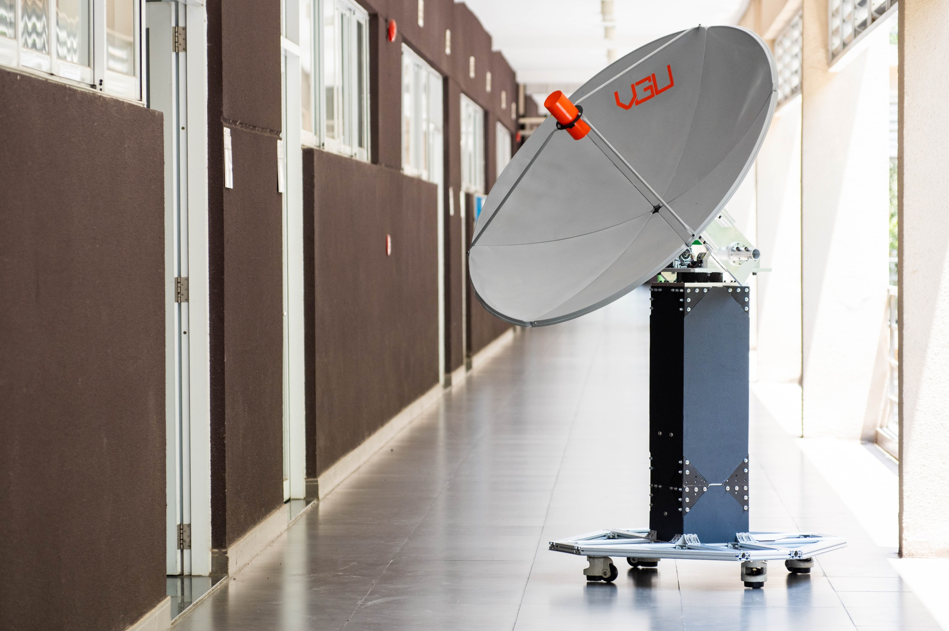
Questions ?

